Slide 1
Differential Equations
MTH-415

Slide 2
Lecture 4

Slide 3
Homogeneous Differential Equations

Slide 4
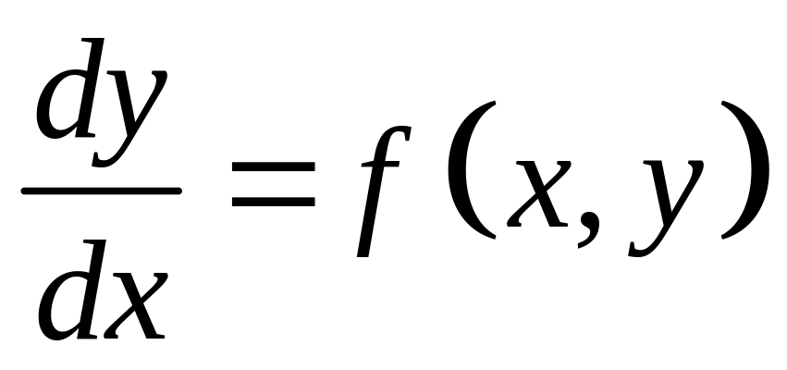
Differential Equation

Slide 5
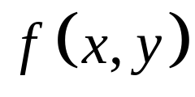
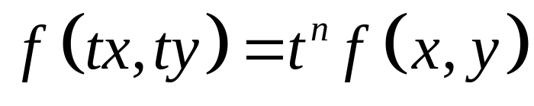
Homogeneous Function
A function is called homogeneous of degree n if
Where t is non zero real number.

Slide 6
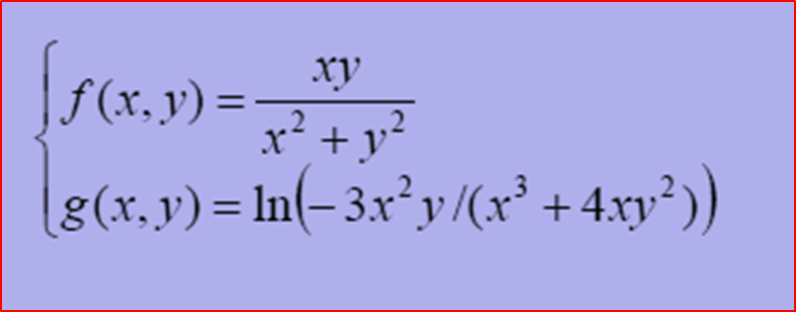
Example
Determine whether the following functions are homogeneous

Slide 7
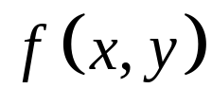
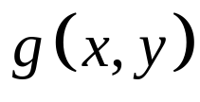
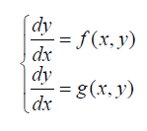
If and are homogeneous function then
the differential equations
Are homogeneous differential equations

Slide 8
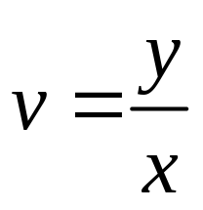
Method of Solution
To solve the homogeneous differential equation
We use the substitution
If is homogeneous of degree zero, then we have

Slide 9
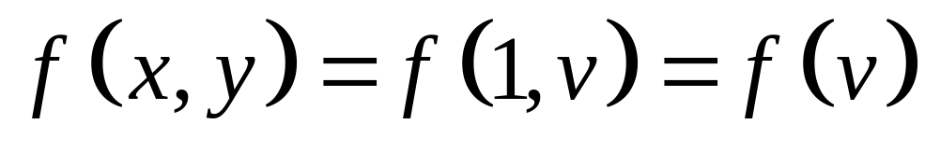
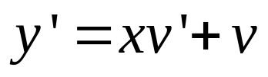

Since , the differential
equation becomes
This is a separable equation. We solve and go back to old variable y through y=xv.

Slide 10
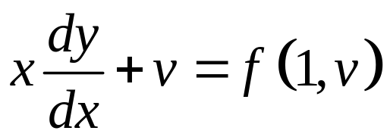
Summary
1. Identify the equation as homogeneous by checking
2. Write out the substitution
3. Through easy differentiation, find the new equation satisfied by the new function v;

Slide 11
4. Solve the new equation (which is always separable) to find v;
5. Go back to the old function y through the substitution y = vx;
6. If we have an IVP, we need to use the initial condition to find the constant of integration.

Slide 12
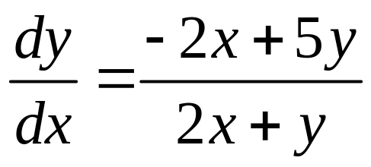
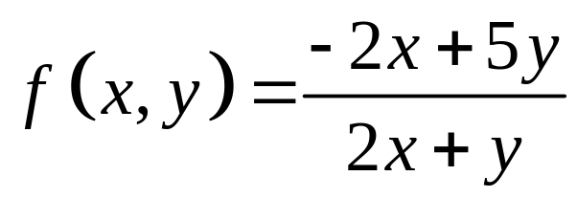
Example 1
Solve the differential equation
Solution:
Step 1. It is easy to check that the function
is a homogeneous function.

Slide 13
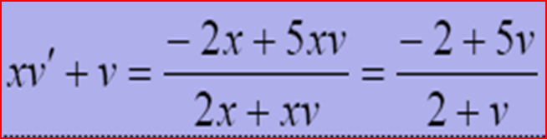
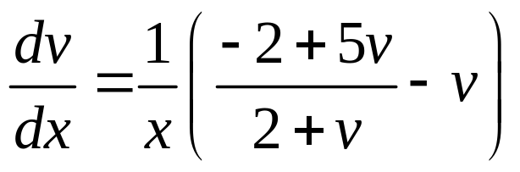
Step 2. To solve the differential equation we substitute
Step 3. Differentiating w.r.t, we obtain
which gives
This is a separable.

Slide 14
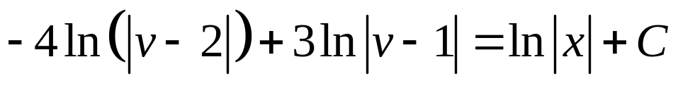
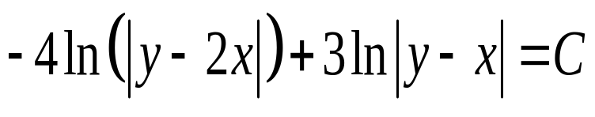
Step 4. Solving by separation of variables all solutions are implicitly given by
Step 5. Going back to the function y through the substitution y=vx, we get

Slide 15
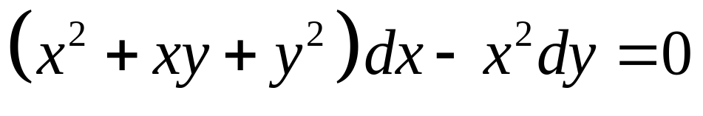
Example 2
Solve the differential equation

Slide 16
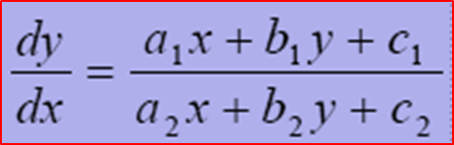
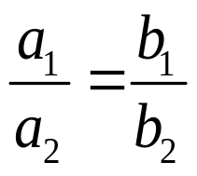


Equations reducible to homogenous form
The differential equation
is not homogenous. However, it can be reduced to a homogenous form as detailed below
Case 1:
We use the substitution which reduces the equation to a separable equation in the variables x and z. Solving the resulting separable equation and replacing z with , we obtain the solution of the given differential equation.

Slide 17
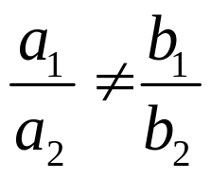
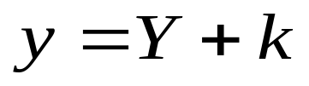

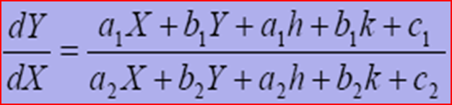
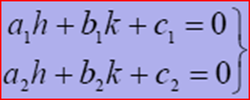
Case 2:
In this case we substitute
Where h and k are constants to be determined. Then the equation becomes
We choose h and k such that

Slide 18
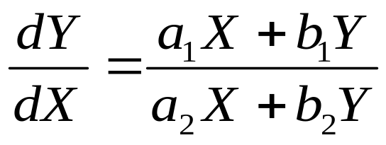
This reduces the equation to
Which is homogenous differential equation in X and Y, and can be solved accordingly. After having solved the last equation we come back to the old variables x and y.

Slide 19
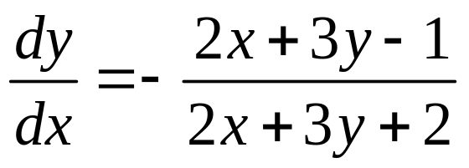
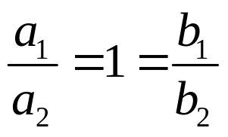

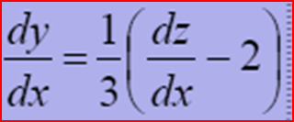
Example 3
Solve the differential equation
Solution:
we substitute , so that
Thus the equation becomes

Slide 20
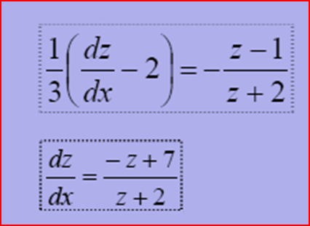
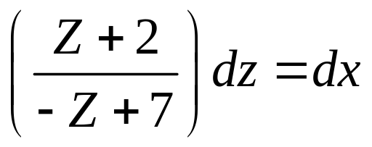


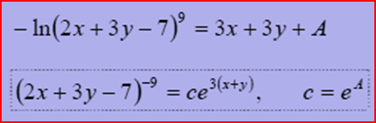
This is a variable separable form, and can be written as
Integrating both sides we get
Simplifying and replacing z with , we obtain

Slide 21
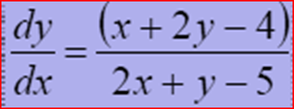
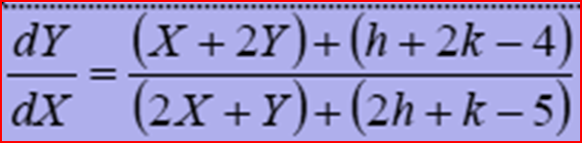
Example 4
Solve the differential equation
Solution:
By substitution
The given differential equation reduces to
We choose h and k such that

Slide 22
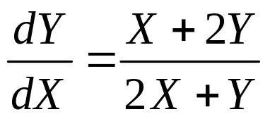
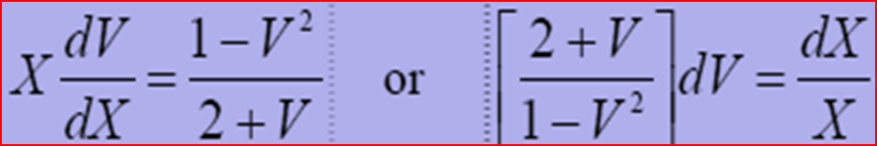
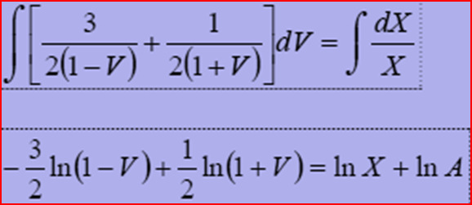
Solving these equations we have h=2, k=1. Therefore, we have
This is a homogenous equation. We substitute Y=VX to obtain
Resolving into partial fractions and integrating both sides we obtain

Slide 23
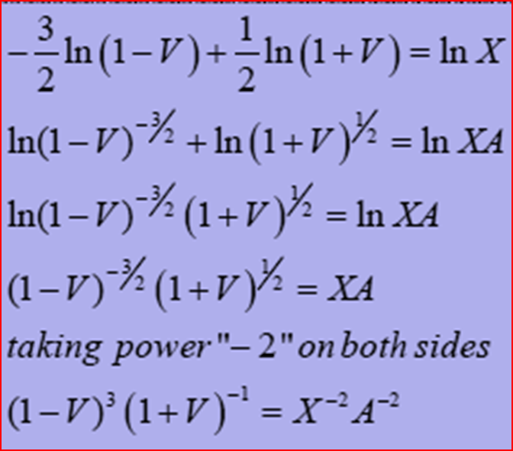
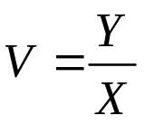
Simplifying and removing (ln) from both sides, we get
put

Slide 24
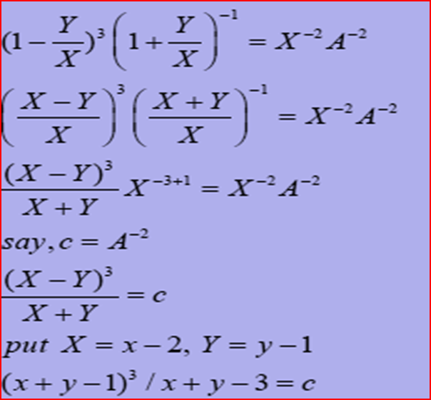

Now substituting , X = x-2, Y =y-1
and simplifying, we obtain
This is solution of the given differential equation, an implicit one.

Slide 25
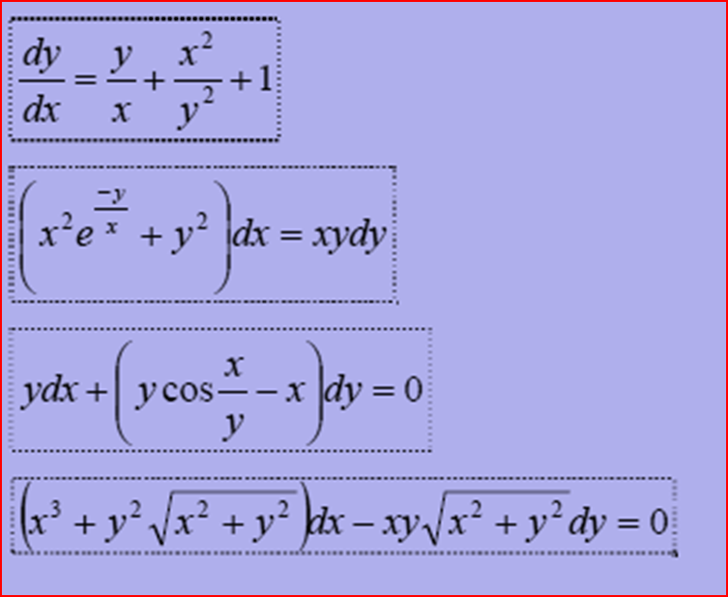
Exercise
Solve the following Differential Equations
Solve the initial value problems

Slide 26
